Slide 1
Rowhammering BIKE

Slide 2

The Bike Cryptosystem
Parameters:
  $r$: degree of polynomials
  $d=w/2$: Hamming weight of polynomials $h_{0}$,$h_{1}$
  $t$: Sum of the Hamming weights

Slide 3
Parameters

Slide 4
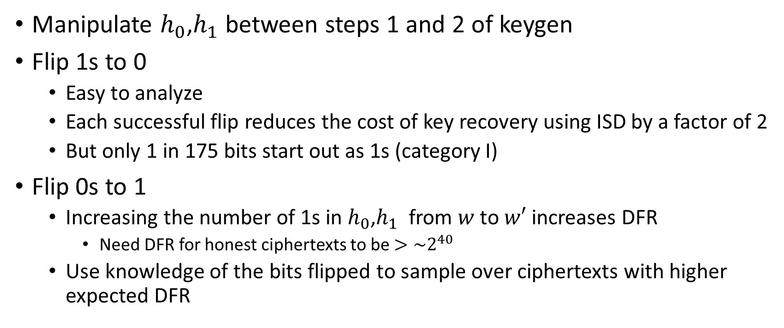
Basic rowhammer strategy
Manipulate $h_{0}$,$h_{1}$ between steps 1 and 2 of keygen
Flip 1s to 0
  Easy to analyze
  Each successful flip reduces the cost of key recovery using ISD by a factor of 2
  But only 1 in 175 bits start out as 1s (category I)
Flip 0s to 1
  Increasing the number of 1s in $h_{0}$,$h_{1}$ from $w$ to $w′$ increases DFR
    Need DFR for honest ciphertexts to be $>\sim 2^{40}$
  Use knowledge of the bits flipped to sample over ciphertexts with higher expected DFR

Slide 5
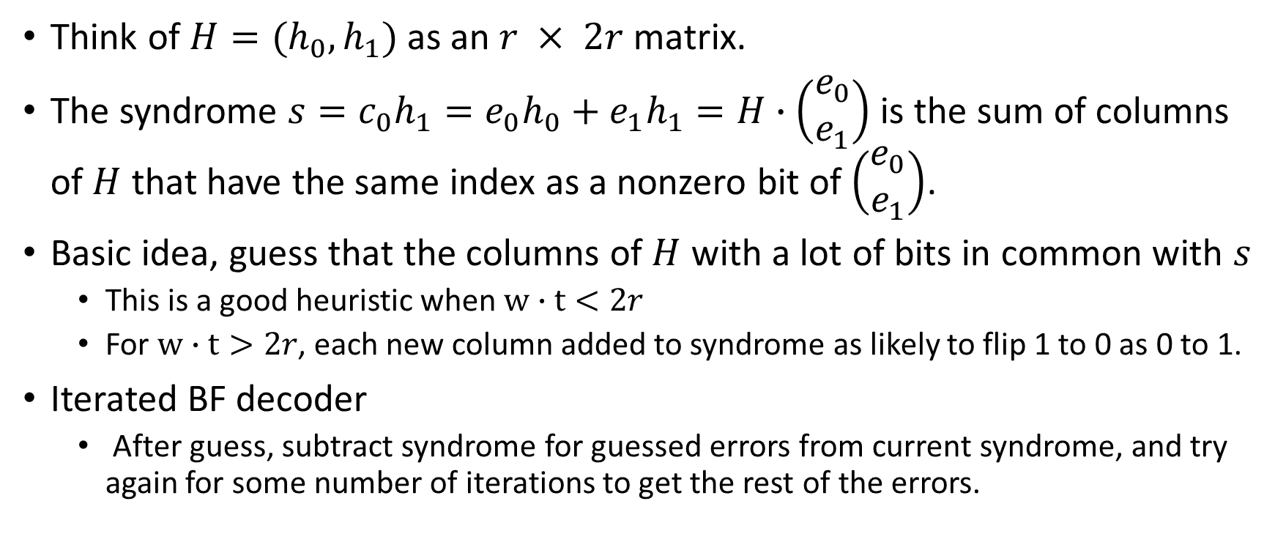
Bitflipping algorithm
Think of $H=(h_{0}, h_{1})$as an $r × 2r$matrix.
The syndrome $s=c_{0}h_{1}={e_{0}h}_{0}+{e_{1}h}_{1}=H∙\left(\begin{matrix}e_{0} \\ e_{1}\end{matrix}\right)$ is the sum of columns of $H$ that have the same index as a nonzero bit of $\left(\begin{matrix}e_{0} \\ e_{1}\end{matrix}\right)$.
Basic idea, guess that the columns of $H$ with a lot of bits in common with $s$
  This is a good heuristic when $w∙t<2r$
  For $w∙t>2r$, each new column added to syndrome as likely to flip 1 to 0 as 0 to 1.
Iterated BF decoder
  After guess, subtract syndrome for guessed errors from current syndrome, and try again for some number of iterations to get the rest of the errors.

Slide 6
Black Grey Flip Decoder

Slide 7
Prior Analysis of the BIKE DFR
QC-MDPC decoders with several shades of Grey (Drucker, Gueron, Kostic 2019) https://eprint.iacr.org/2019/1423
  Empirical measurements of where DFR becomes noticeable, eyeballing it (Actually, eyeballing how parameters changed when BIKE changed from targeting CPA to CCA), it looks like we could effectively increase w by about 30 and still have a reasonable chance of decoding random honest ciphertexts
Valentin Vasseur PHD defense https://who.rocq.inria.fr/Valentin.Vasseur/papers/2021-03-29-thesis-Vasseur.pdf
  (Chapter 16: Error Floors) gives hard to decode error patterns related to the private key. DFR depends on the distance of the error to these patterns. These could be used by a rowhammer attacker to failure boost, since the rowhammer attacker would know where some of the bits of the rowhammered private key are. Rowhammerer could potentially sample ciphertexts about 20 bits closer than random to problematic patterns for ~2^50 work.

